Slide 1
GRAND PARK
DISTRICT 9 HCMC
GRAND Park CITY

Slide 2
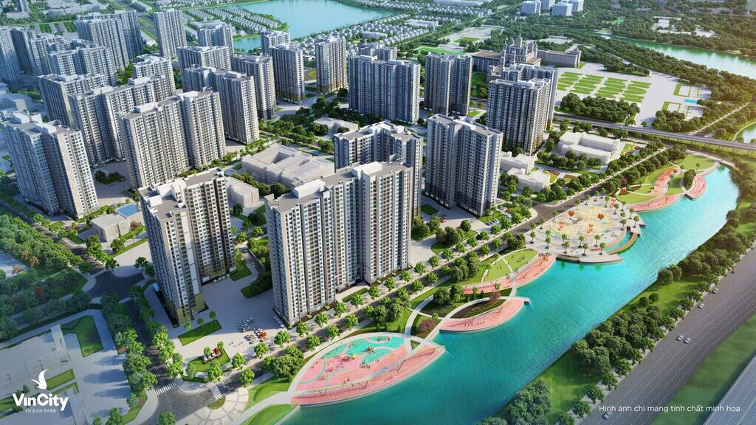
Warning : Whilst every care has been taken to ensure accuracy in the preparation of the information contained herein, no warranties whatsoever are given or legal representative is provided in respect thereon. The vendor reserves the rights to modify features, the units, plans or the development or any part thereof as may be approved or required by the relevant authorities.
GRAND park CITY

Slide 3
PROJECT INFORMATION
The Developer
Scale
Location
~272 hectare
Green area~36 ha
District 9
Products
71
buidings
44.000
apartments
1.600 townhouses
& villas

Slide 4
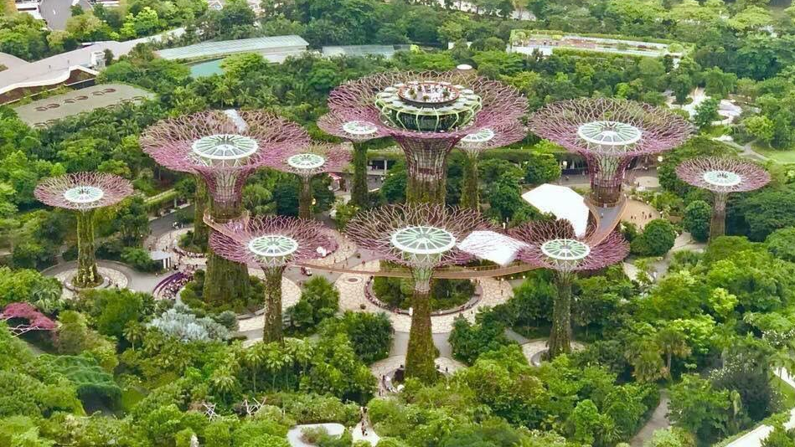
Warning : Whilst every care has been taken to ensure accuracy in the preparation of the information contained herein, no warranties whatsoever are given or legal representative is provided in respect thereon. The vendor reserves the rights to modify features, the units, plans or the development or any part thereof as may be approved or required by the relevant authorities.
AMENITIES
Southeast Asia's largest riverine park (36 hectare)
Light as style of Gardens by the Bay

Slide 5
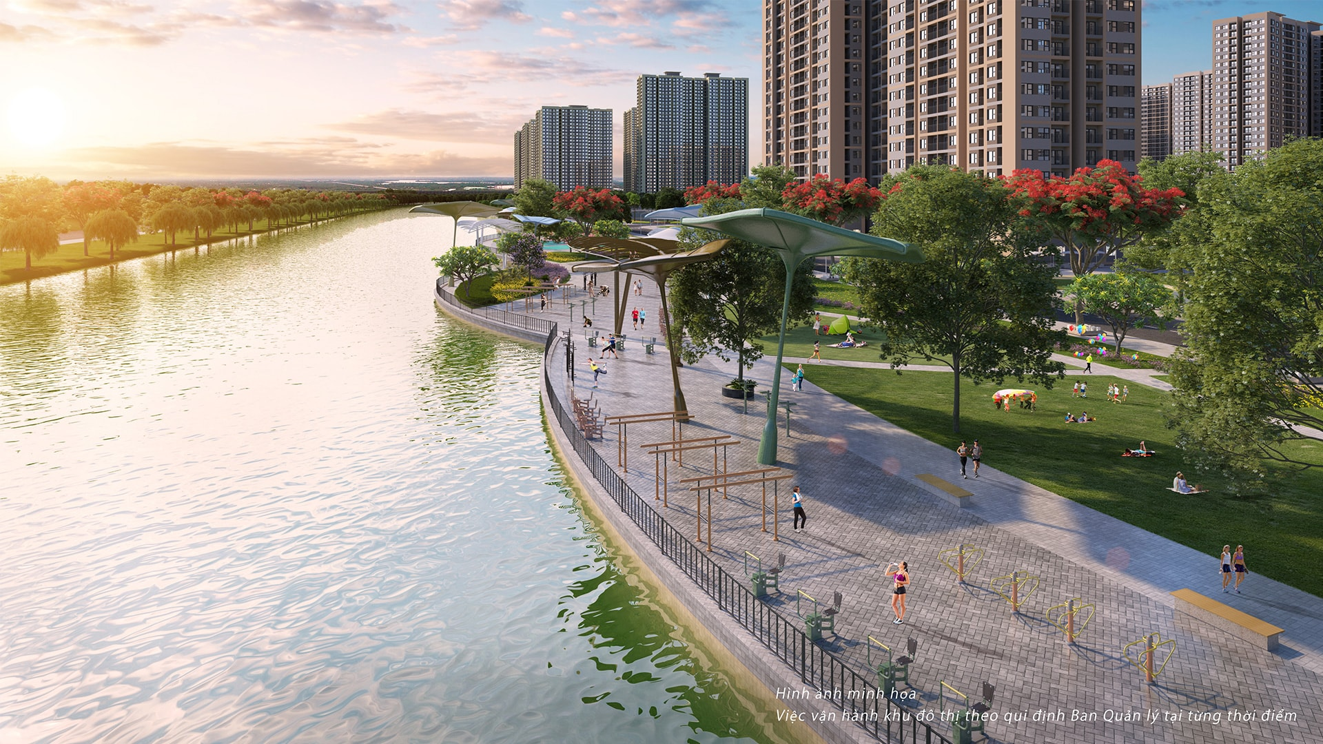
Warning : Whilst every care has been taken to ensure accuracy in the preparation of the information contained herein, no warranties whatsoever are given or legal representative is provided in respect thereon. The vendor reserves the rights to modify features, the units, plans or the development or any part thereof as may be approved or required by the relevant authorities.
AMENITIES
Grassland in main square : 2 ha
Jogging track along the river

Slide 6
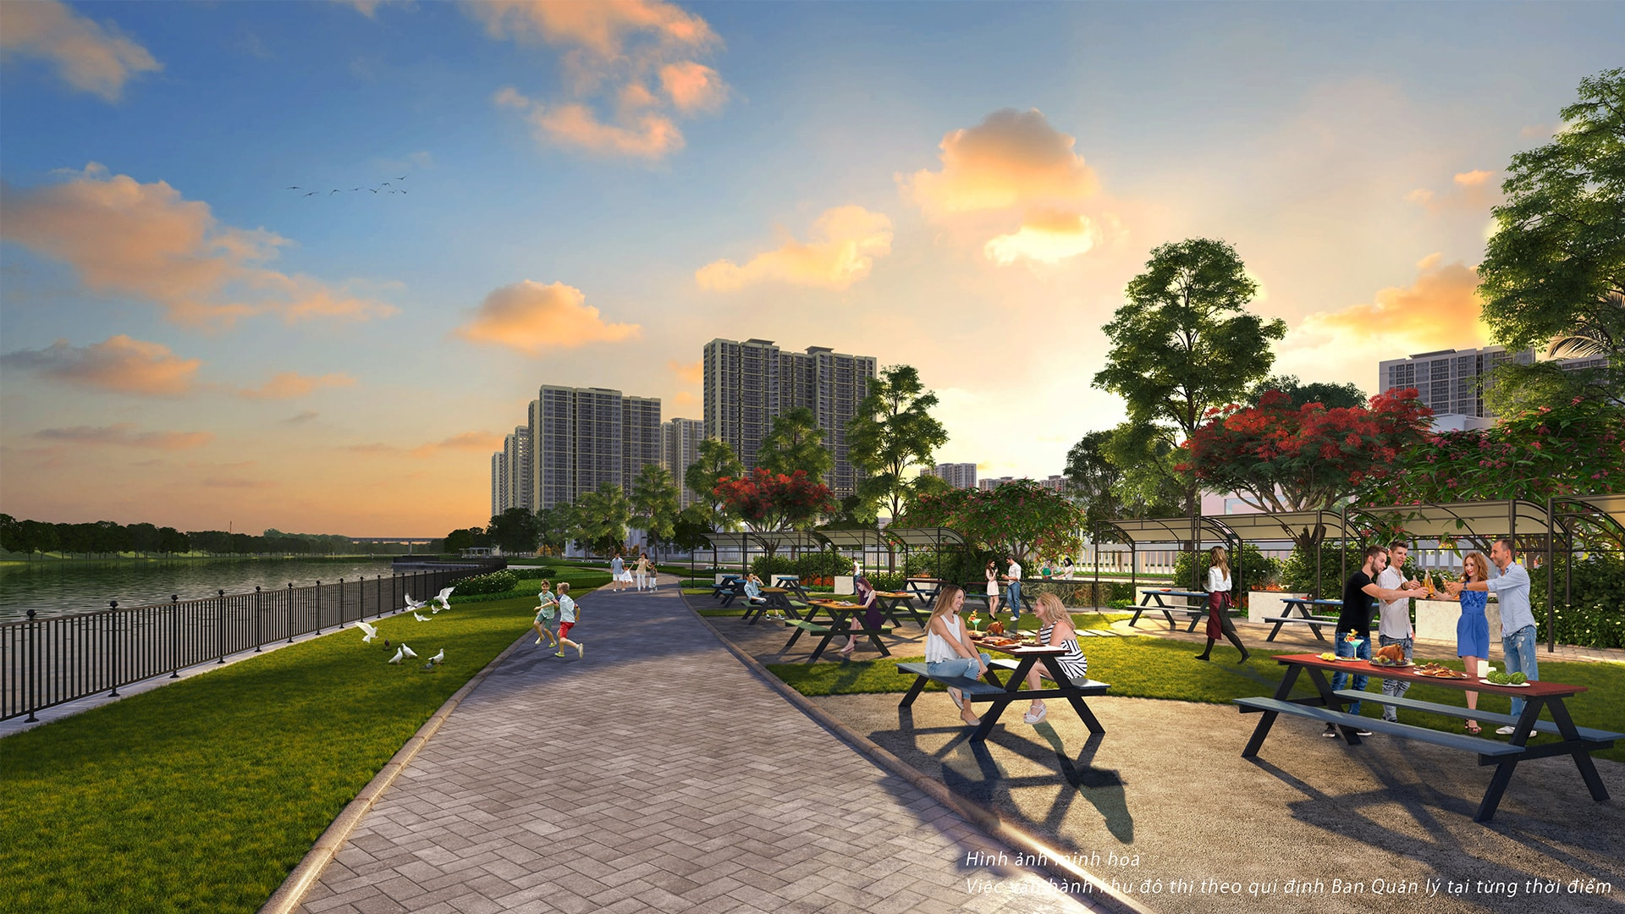
Warning : Whilst every care has been taken to ensure accuracy in the preparation of the information contained herein, no warranties whatsoever are given or legal representative is provided in respect thereon. The vendor reserves the rights to modify features, the units, plans or the development or any part thereof as may be approved or required by the relevant authorities.
AMENITIES
BBQ area is expected 150 boxes

Slide 7
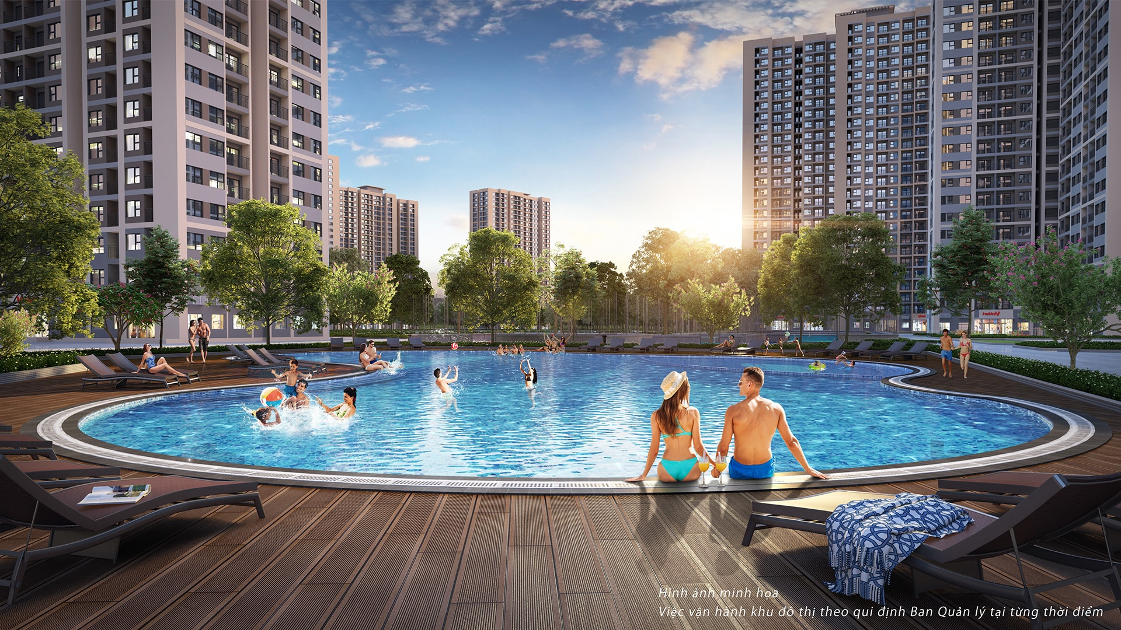
Warning : Whilst every care has been taken to ensure accuracy in the preparation of the information contained herein, no warranties whatsoever are given or legal representative is provided in respect thereon. The vendor reserves the rights to modify features, the units, plans or the development or any part thereof as may be approved or required by the relevant authorities.
AMENITIES
The artificial river systems, white sand, clean water that residents can use comfortably; duck boat, canoe yake

Slide 8
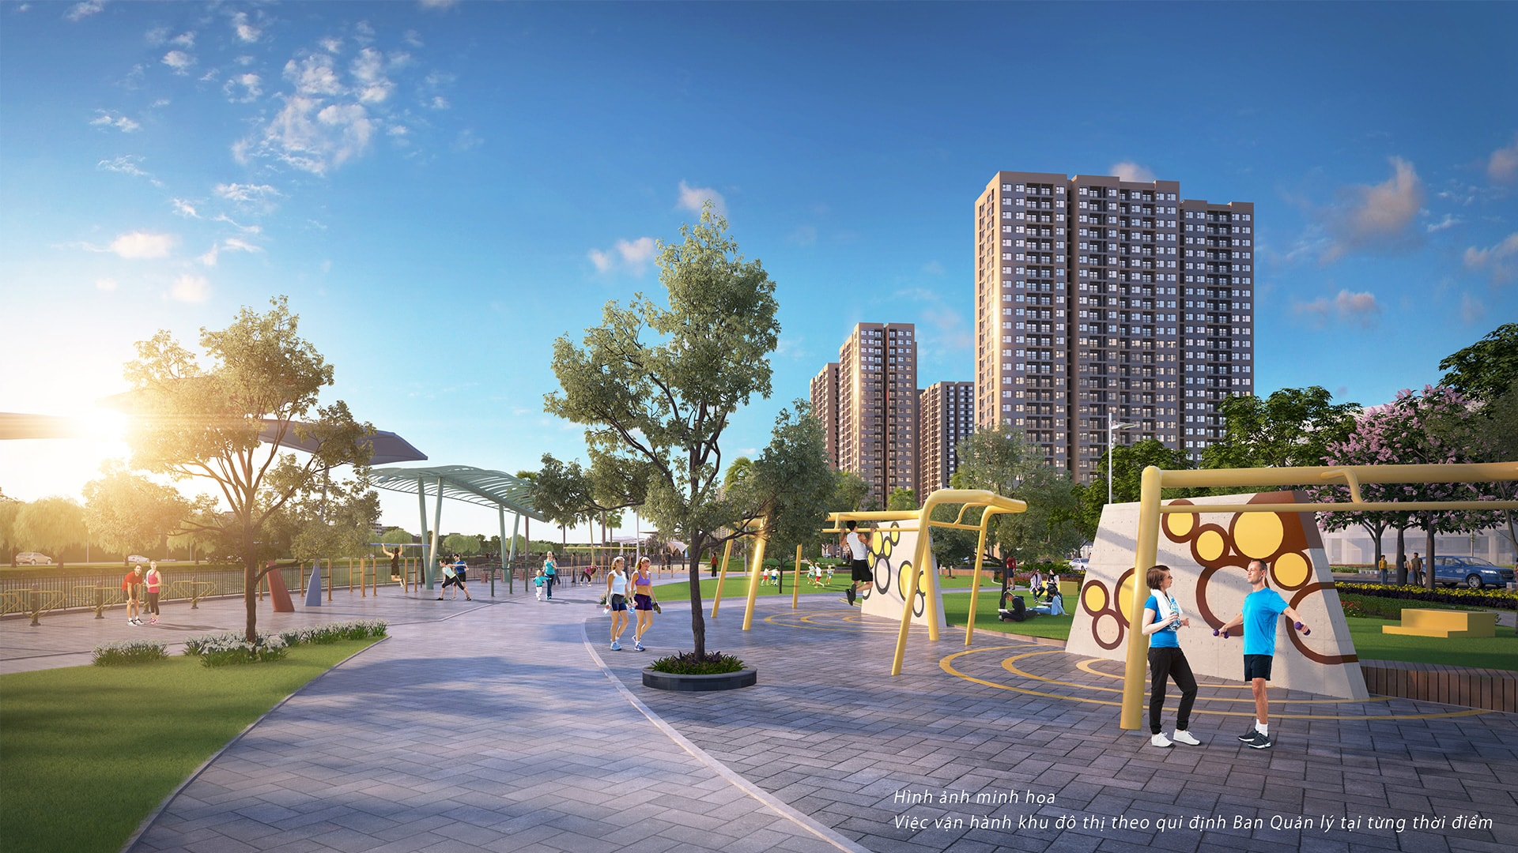
Warning : Whilst every care has been taken to ensure accuracy in the preparation of the information contained herein, no warranties whatsoever are given or legal representative is provided in respect thereon. The vendor reserves the rights to modify features, the units, plans or the development or any part thereof as may be approved or required by the relevant authorities.
AMENITIES
Outdoor gymnasiums with 1000 various machines are spreaded out around the park area.

Slide 9
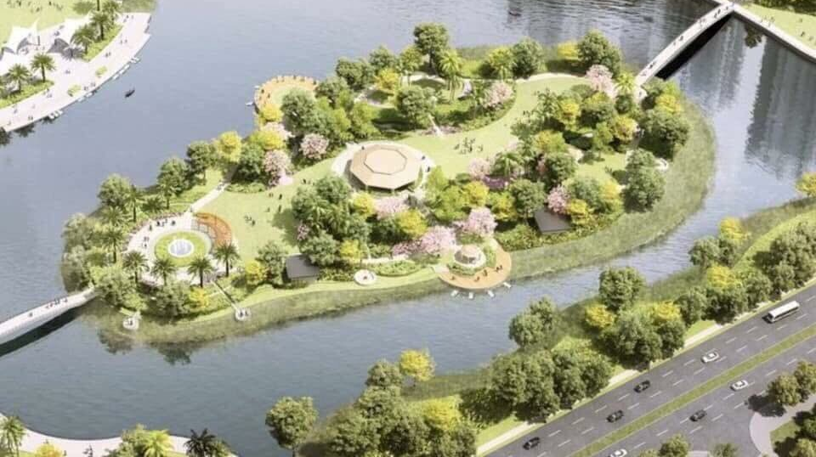
Warning : Whilst every care has been taken to ensure accuracy in the preparation of the information contained herein, no warranties whatsoever are given or legal representative is provided in respect thereon. The vendor reserves the rights to modify features, the units, plans or the development or any part thereof as may be approved or required by the relevant authorities.
AMENITIES
Ayurvedic island: 2 ha- Yoga, Meditation, Chinese chess are arranged around the island (100 boards)

Slide 10
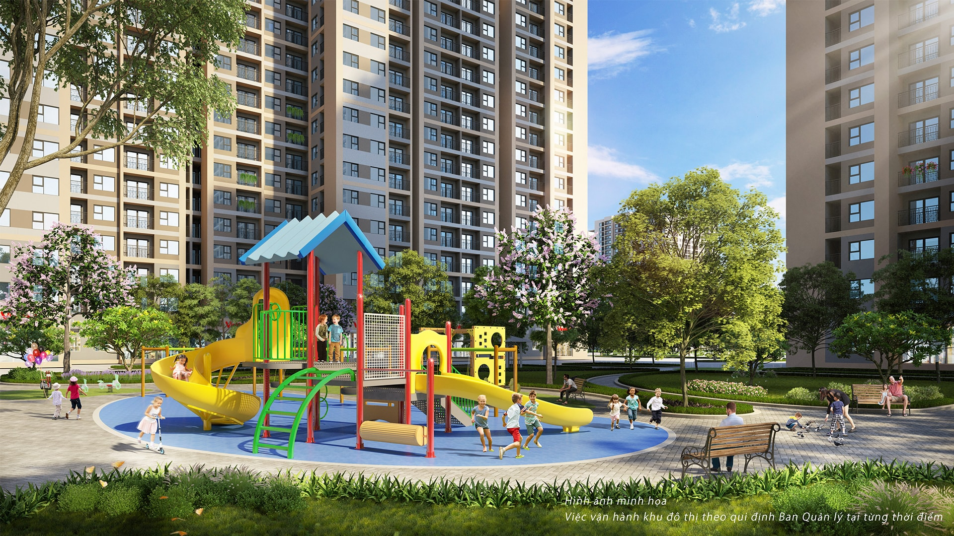
Warning : Whilst every care has been taken to ensure accuracy in the preparation of the information contained herein, no warranties whatsoever are given or legal representative is provided in respect thereon. The vendor reserves the rights to modify features, the units, plans or the development or any part thereof as may be approved or required by the relevant authorities.
AMENITIES
Kid zone 5000sqm, with the fountains designe to combine the light like Nguyen Hue walking street.

Slide 11
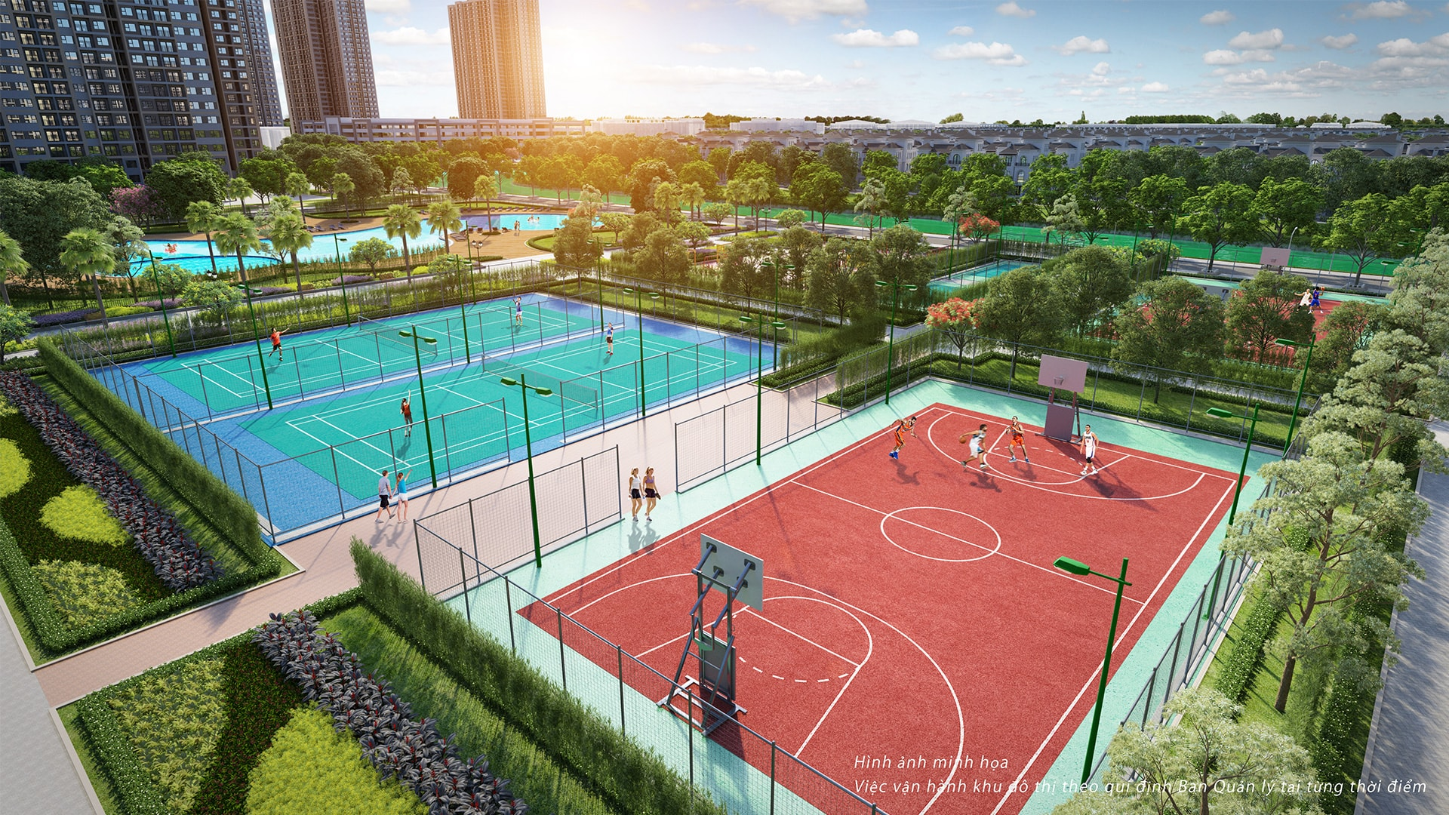
Warning : Whilst every care has been taken to ensure accuracy in the preparation of the information contained herein, no warranties whatsoever are given or legal representative is provided in respect thereon. The vendor reserves the rights to modify features, the units, plans or the development or any part thereof as may be approved or required by the relevant authorities.
AMENITIES
170 Football fields, Tennis courts, Basketball courts

Slide 12
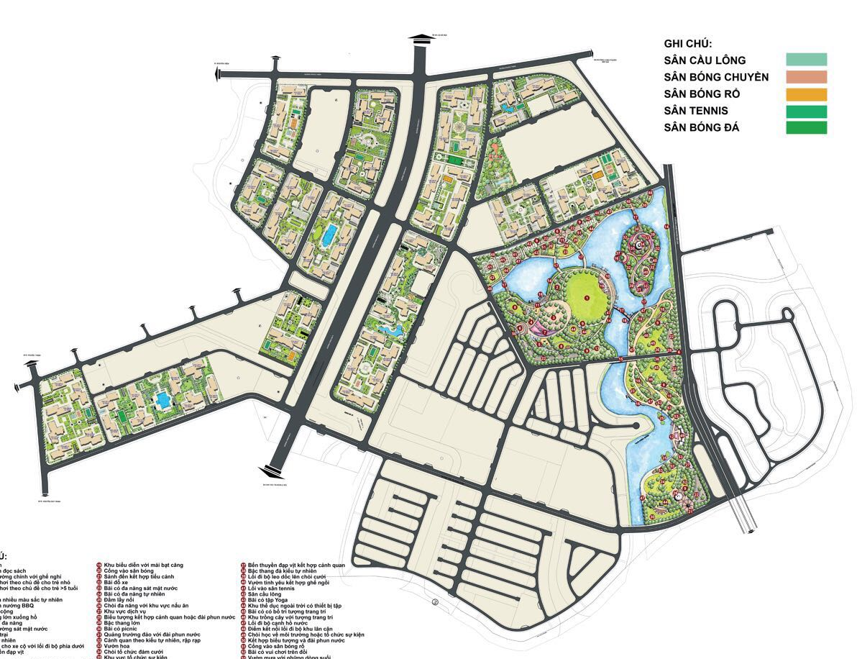
MASTER PLAN
THE RIVER
LEGEND
BADMINTON COURT
VOLLEYBALL COURSE
BASKETBALL YARD
TENNIS COURT
FOOTBALL PITCHES
THE RESORT
THE LIGHT
THE CENTRAL
Warning : Whilst every care has been taken to ensure accuracy in the preparation of the information contained herein, no warranties whatsoever are given or legal representative is provided in respect thereon. The vendor reserves the rights to modify features, the units, plans or the development or any part thereof as may be approved or required by the relevant authorities.

Slide 13
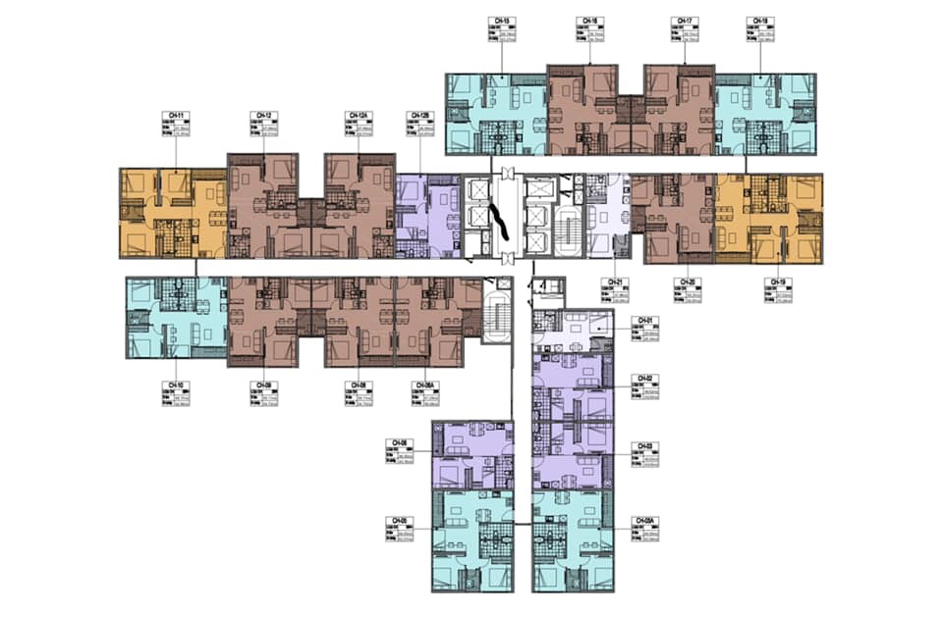
FLOOR PLAN
Warning : Whilst every care has been taken to ensure accuracy in the preparation of the information contained herein, no warranties whatsoever are given or legal representative is provided in respect thereon. The vendor reserves the rights to modify features, the units, plans or the development or any part thereof as may be approved or required by the relevant authorities.

Slide 14
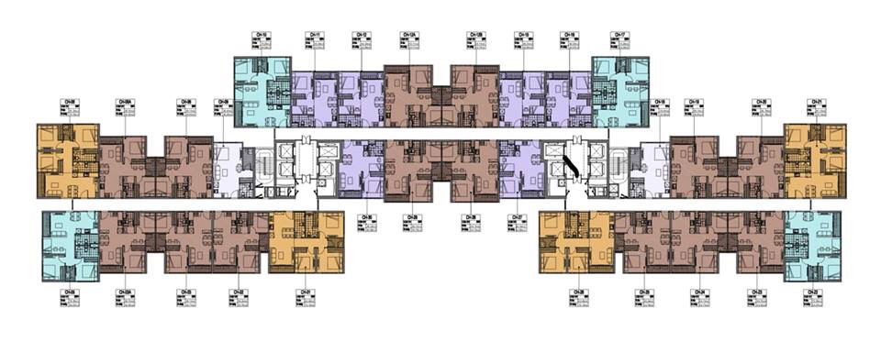
FLOOR PLAN
Warning : Whilst every care has been taken to ensure accuracy in the preparation of the information contained herein, no warranties whatsoever are given or legal representative is provided in respect thereon. The vendor reserves the rights to modify features, the units, plans or the development or any part thereof as may be approved or required by the relevant authorities.

Slide 15
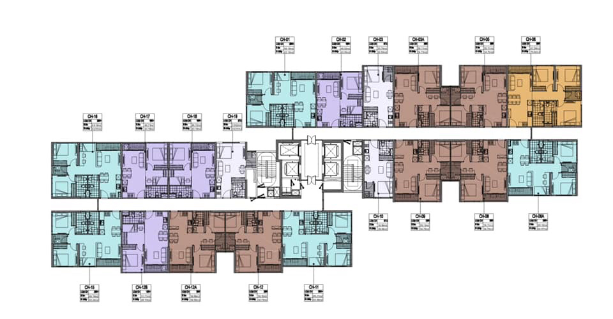
FLOOR PLAN
Warning : Whilst every care has been taken to ensure accuracy in the preparation of the information contained herein, no warranties whatsoever are given or legal representative is provided in respect thereon. The vendor reserves the rights to modify features, the units, plans or the development or any part thereof as may be approved or required by the relevant authorities.

Slide 16
DESIGN CONCEPT
1 BEDROOM
Warning : Whilst every care has been taken to ensure accuracy in the preparation of the information contained herein, no warranties whatsoever are given or legal representative is provided in respect thereon. The vendor reserves the rights to modify features, the units, plans or the development or any part thereof as may be approved or required by the relevant authorities.

Slide 17
TARGET CLIENT
The University Students
The young and single
Warning : Whilst every care has been taken to ensure accuracy in the preparation of the information contained herein, no warranties whatsoever are given or legal representative is provided in respect thereon. The vendor reserves the rights to modify features, the units, plans or the development or any part thereof as may be approved or required by the relevant authorities.

Slide 18
TARGET CLIENT
Young Married Families
Warning : Whilst every care has been taken to ensure accuracy in the preparation of the information contained herein, no warranties whatsoever are given or legal representative is provided in respect thereon. The vendor reserves the rights to modify features, the units, plans or the development or any part thereof as may be approved or required by the relevant authorities.

Slide 19
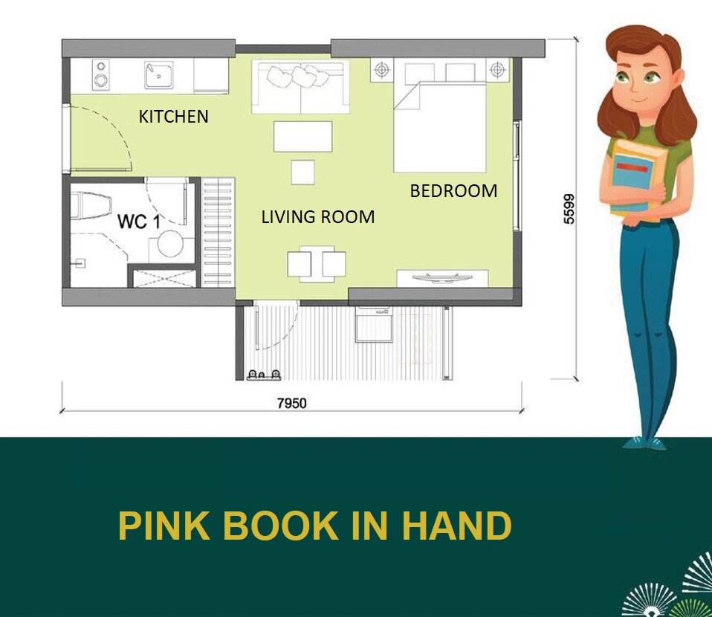
DESIGN
STUDIO APARTMENT
Bedroom and living room
At the same space
Warning : Whilst every care has been taken to ensure accuracy in the preparation of the information contained herein, no warranties whatsoever are given or legal representative is provided in respect thereon. The vendor reserves the rights to modify features, the units, plans or the development or any part thereof as may be approved or required by the relevant authorities.

Slide 20
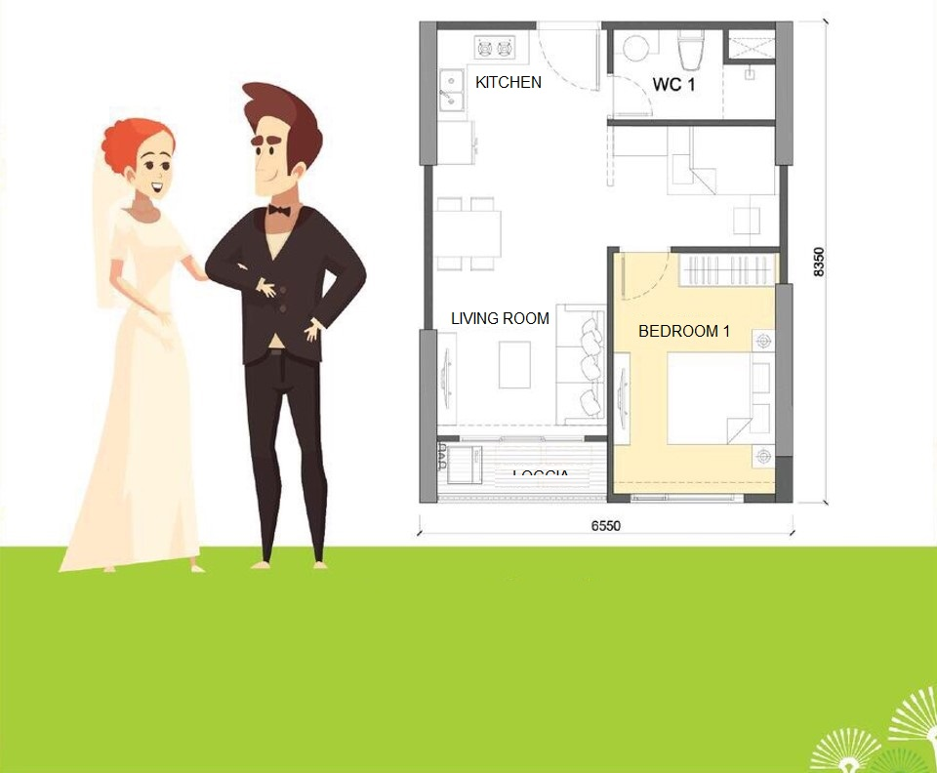
DESIGN
1 BEDROOM + 1WC
Warning : Whilst every care has been taken to ensure accuracy in the preparation of the information contained herein, no warranties whatsoever are given or legal representative is provided in respect thereon. The vendor reserves the rights to modify features, the units, plans or the development or any part thereof as may be approved or required by the relevant authorities.

Slide 21
DESIGN CONCEPT
2 BEDROOM
Warning : Whilst every care has been taken to ensure accuracy in the preparation of the information contained herein, no warranties whatsoever are given or legal representative is provided in respect thereon. The vendor reserves the rights to modify features, the units, plans or the development or any part thereof as may be approved or required by the relevant authorities.

Slide 22
TARGET CLIENT
Family with 1-2 childen
Warning : Whilst every care has been taken to ensure accuracy in the preparation of the information contained herein, no warranties whatsoever are given or legal representative is provided in respect thereon. The vendor reserves the rights to modify features, the units, plans or the development or any part thereof as may be approved or required by the relevant authorities.

Slide 23
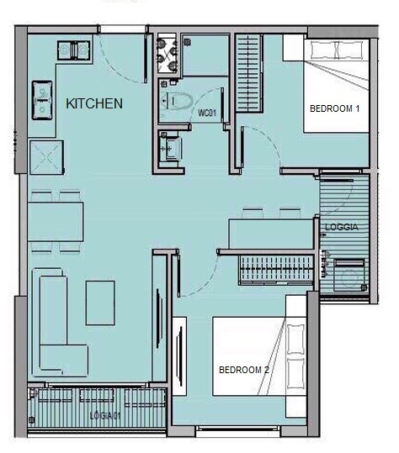
DESIGN
2 BEDROOM +1WC
Warning : Whilst every care has been taken to ensure accuracy in the preparation of the information contained herein, no warranties whatsoever are given or legal representative is provided in respect thereon. The vendor reserves the rights to modify features, the units, plans or the development or any part thereof as may be approved or required by the relevant authorities.

Slide 24
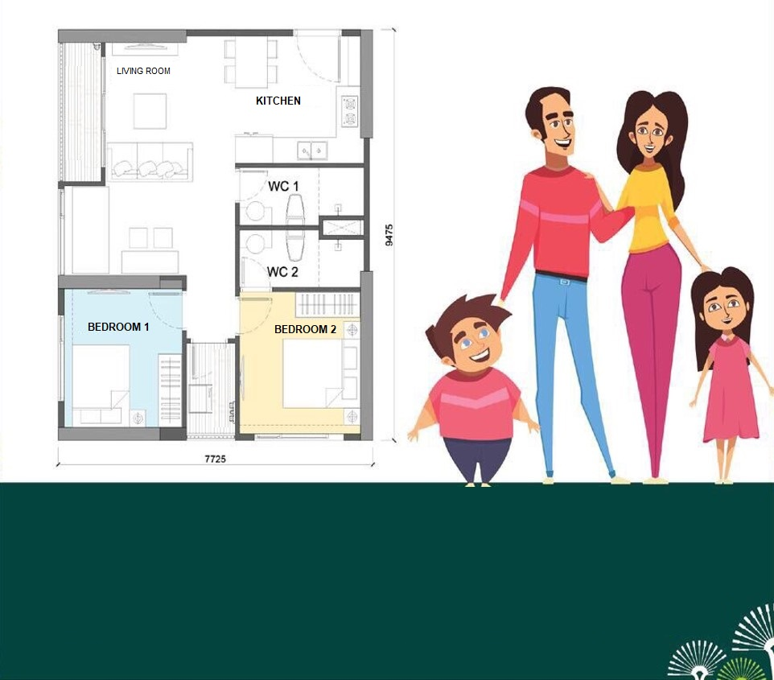
DESIGN
2 BEDROOM + 2WC
Warning : Whilst every care has been taken to ensure accuracy in the preparation of the information contained herein, no warranties whatsoever are given or legal representative is provided in respect thereon. The vendor reserves the rights to modify features, the units, plans or the development or any part thereof as may be approved or required by the relevant authorities.

Slide 25
DESIGN CONCEPT
3 BEDROOM
LOGO ĐẠI LÝ
Warning : Whilst every care has been taken to ensure accuracy in the preparation of the information contained herein, no warranties whatsoever are given or legal representative is provided in respect thereon. The vendor reserves the rights to modify features, the units, plans or the development or any part thereof as may be approved or required by the relevant authorities.

Slide 26
TARGET CLIENT
Family of 3 generations
Multi-child families
Warning : Whilst every care has been taken to ensure accuracy in the preparation of the information contained herein, no warranties whatsoever are given or legal representative is provided in respect thereon. The vendor reserves the rights to modify features, the units, plans or the development or any part thereof as may be approved or required by the relevant authorities.

Slide 27
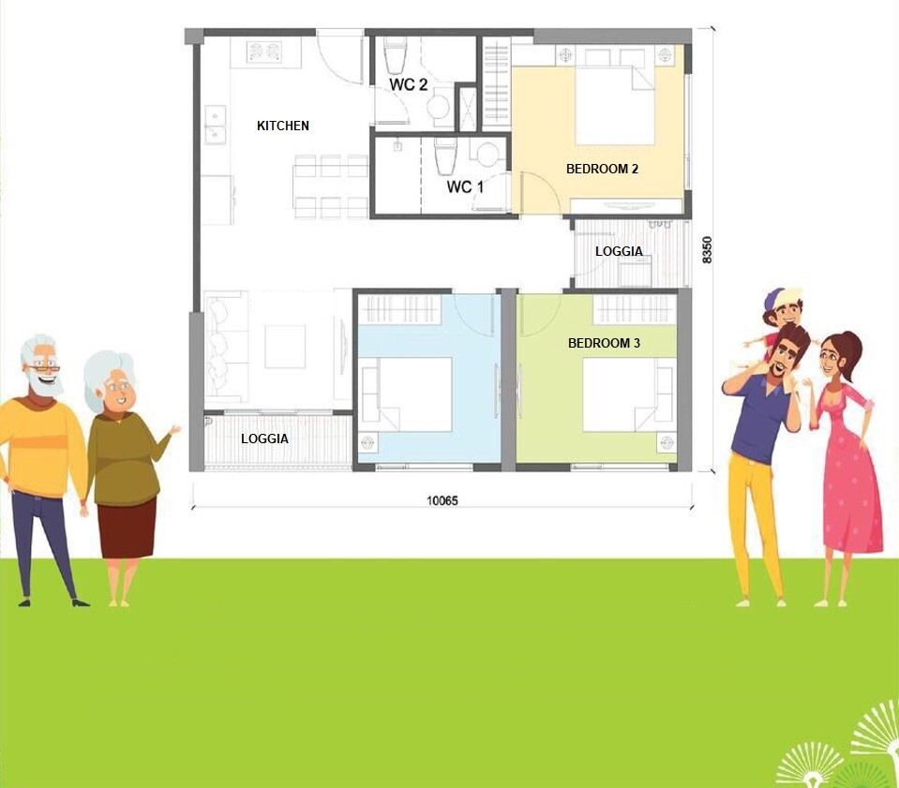
DESIGN
3 BEDROOM
Warning : Whilst every care has been taken to ensure accuracy in the preparation of the information contained herein, no warranties whatsoever are given or legal representative is provided in respect thereon. The vendor reserves the rights to modify features, the units, plans or the development or any part thereof as may be approved or required by the relevant authorities.

Slide 28
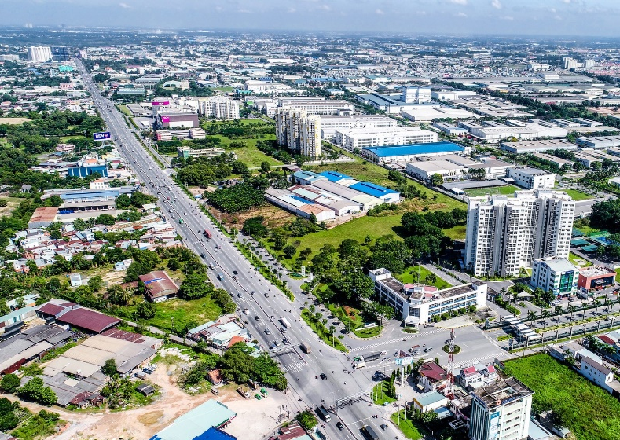
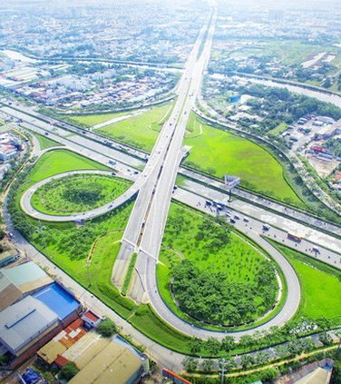
CONNECTIVITY
DISTRICT 9
Nearby
BINH DUONG PROVINCE
9 km
BIEN HOA CITY
18 km
NHON TRACH NEW CITY
15 km
Warning : Whilst every care has been taken to ensure accuracy in the preparation of the information contained herein, no warranties whatsoever are given or legal representative is provided in respect thereon. The vendor reserves the rights to modify features, the units, plans or the development or any part thereof as may be approved or required by the relevant authorities.

Slide 29
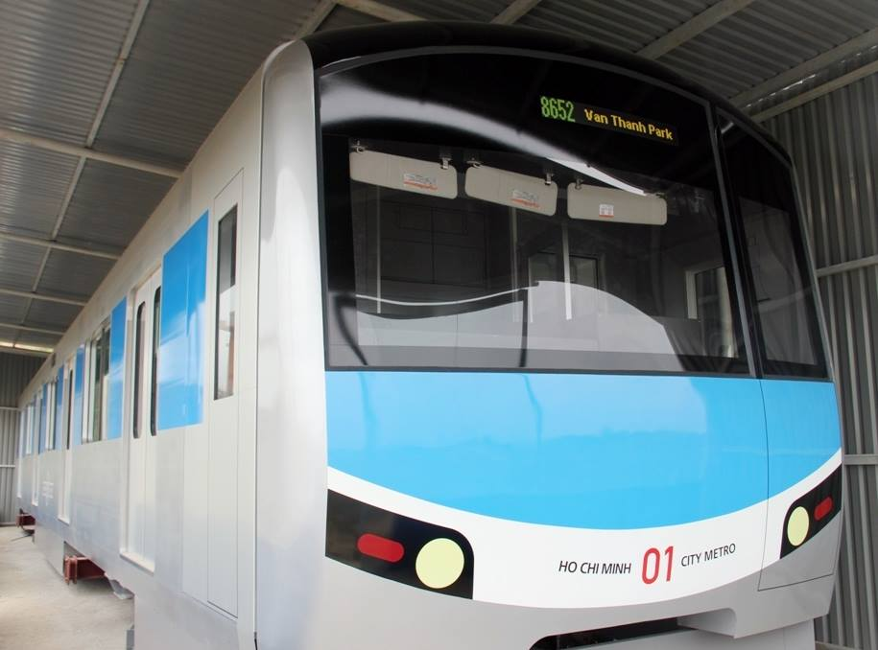
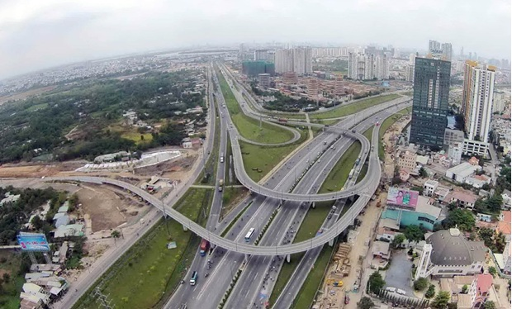
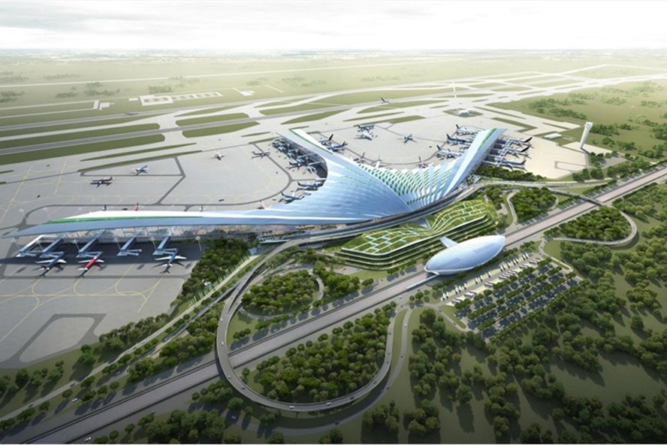
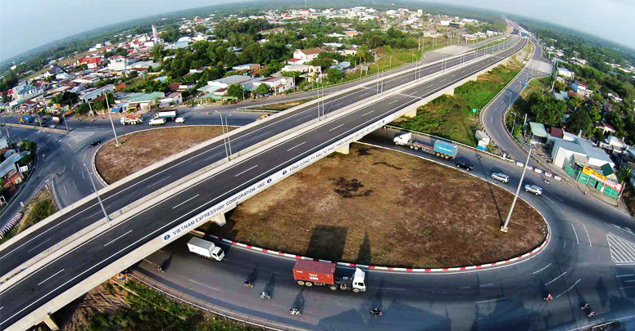
LINK TO SURROUNDING AREA
RING ROAD 3
Facade (1 km)
2 km
METRO LINE NO.1
LONG THANH – DAU GIAY EXPRESSWAY
4 km
LONG THANH AIRPORT
18 km
Warning : Whilst every care has been taken to ensure accuracy in the preparation of the information contained herein, no warranties whatsoever are given or legal representative is provided in respect thereon. The vendor reserves the rights to modify features, the units, plans or the development or any part thereof as may be approved or required by the relevant authorities.

Slide 30
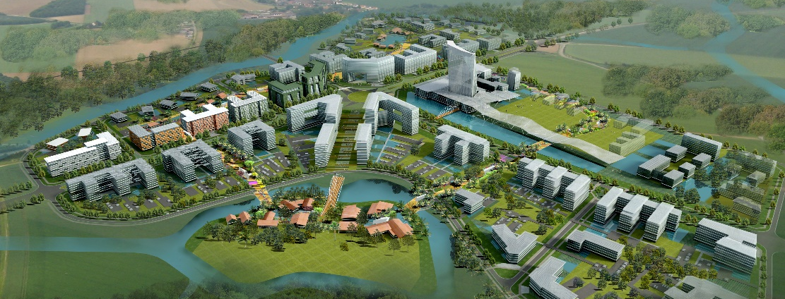
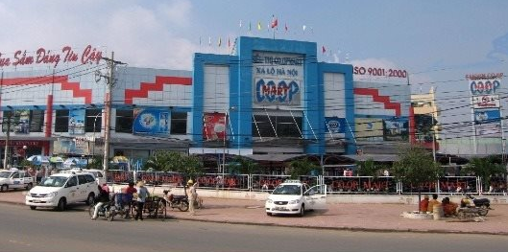
LINK TO THE ULTILITIES
CO.OP MART DIST. 9
3.8 km
2 km
Saigon Hi-tech Park
RACH CHIEC
GOLF COURT
SUOI TIEN AMUSEMENT PARK
4 km
6 km
VIETNAM GOLF & COUNTRY CLUB Q9
CITY GENERAL
HOSPITAL
5.6 km
1 km
Warning : Whilst every care has been taken to ensure accuracy in the preparation of the information contained herein, no warranties whatsoever are given or legal representative is provided in respect thereon. The vendor reserves the rights to modify features, the units, plans or the development or any part thereof as may be approved or required by the relevant authorities.

Slide 31
03
EXPECTED HANDOVER CONDITION
Warning : Whilst every care has been taken to ensure accuracy in the preparation of the information contained herein, no warranties whatsoever are given or legal representative is provided in respect thereon. The vendor reserves the rights to modify features, the units, plans or the development or any part thereof as may be approved or required by the relevant authorities.

Slide 32
01
HAND-OVER STANDARD / MINIMUM STANDARD
TIMBER FLOOR AT BEDROOM
NO WARDROBE/ CABINET
SANITARY WARES
Lavabo, Toilet, Stand shower
Cabinet kitchen
Sink & water tap
Built-in wardrobe at bedroom
NO OVEN – NO HOOD
NO ELECTRIC
WATER HEATER
NO AC
Do not have sleeve
Connect via pipe & standby head
Warning : Whilst every care has been taken to ensure accuracy in the preparation of the information contained herein, no warranties whatsoever are given or legal representative is provided in respect thereon. The vendor reserves the rights to modify features, the units, plans or the development or any part thereof as may be approved or required by the relevant authorities.

Slide 33
02
PRIMARY HAND-OVER STANDARD
SANITARY WARES
KITCHEN &
BATHROOM CABINET
NO WARDROBE
Lavabo, Toilet, Stand shower
Cabinet kitchen
Sink & water tap
(In all rooms)
OVEN – HOOD
AC
ELECTRIC WATER
HEATER
Warning : Whilst every care has been taken to ensure accuracy in the preparation of the information contained herein, no warranties whatsoever are given or legal representative is provided in respect thereon. The vendor reserves the rights to modify features, the units, plans or the development or any part thereof as may be approved or required by the relevant authorities.

Slide 34
03
HAND-OVER STANDARD OF PRIMARY INTERIOR
FURNITURE
SANITARY WARES
KITCHEN CABINET, BATHROOM CABINET, WARDROBE
OVEN - HOOD
AC
Lavabo, Toilet, Stand shower
For master bedroom
ELECTRIC
WATER HEATER
PRIMARY INTERIOR
FURNITURE
NO ELECTRIC/ REFRIGERATION & HOUSEHOLD APPLIANCES
Sofa, Coffe table, Dining table, bed + mattress, Window coverings
Television, Refrigerator
Dishes
Warning : Whilst every care has been taken to ensure accuracy in the preparation of the information contained herein, no warranties whatsoever are given or legal representative is provided in respect thereon. The vendor reserves the rights to modify features, the units, plans or the development or any part thereof as may be approved or required by the relevant authorities.

Slide 35
PAYMENT SCHEDULE
SIGNING SALES & PURCHASING CONTRACT
90 DAYS LATER
180 DAYS LATER
TECHCOMBANK
10% of total price
10% of total price
10% of total price
Bank loan supporting up to 35 years
Warning : Whilst every care has been taken to ensure accuracy in the preparation of the information contained herein, no warranties whatsoever are given or legal representative is provided in respect thereon. The vendor reserves the rights to modify features, the units, plans or the development or any part thereof as may be approved or required by the relevant authorities.

Slide 36
WHY CHOOSE VINCITY
Only 200 mil. VND paid
within 6 months, get HOUSEHOLD BOOK in SAI GON
Continue making
payment on the value of contract 2 YEARS LATER.
The apartment is
designed SMARTLY to serve many different
kinds of resident.
RING ROAD 3 goes
around the center of the project
Urban planning is synchronized,
civilized, modern, especially owning SOUTHEAST ASIA'S LARGEST RIVERINE PARK (36 hectare)
A lot of ultilities
around
Warning : Whilst every care has been taken to ensure accuracy in the preparation of the information contained herein, no warranties whatsoever are given or legal representative is provided in respect thereon. The vendor reserves the rights to modify features, the units, plans or the development or any part thereof as may be approved or required by the relevant authorities.

Slide 37
PROJECT TEAM
The Design consult by :
EDSA (America) – Leading designer company with over 50 years experience
WEST GREEN DESIGN (Canada), Head office at Vancouver, Canada
Warning : Whilst every care has been taken to ensure accuracy in the preparation of the information contained herein, no warranties whatsoever are given or legal representative is provided in respect thereon. The vendor reserves the rights to modify features, the units, plans or the development or any part thereof as may be approved or required by the relevant authorities.

Slide 38
VIPROPERTY JOINT STOCK COMPANY
C1 - SH.09 Vinhomes Central Park, 720A Dien Bien Phu Str, Ward 22, Binh Thanh Dist, HCMC

